Slide 1

APEX INSTITUTE OF TECHNOLOGY
DEPARTMENT OF COMPUTER SCIENCE & ENGINEERING
Statistics for Data Science(23CSH-233)
Faculty: Prof. (Dr.) Madan Lal Saini(E13485)
Lecture – 26
Likelihood and Probability
DISCOVER . LEARN . EMPOWER

Slide 2
Statistics for Data Science : Course Objectives
COURSE OBJECTIVES
The Course aims to:
To equip students with the skills to summarize and interpret data using descriptive statistics and visualization techniques.
To develop a foundational understanding of probability and its applications in data science.
To enable students to perform hypothesis testing and construct confidence intervals for statistical inference.
To teach students how to build and assess linear and logistic regression models for predictive analysis.
To provide hands-on experience with statistical software for data manipulation, analysis, and visualization.

Slide 3
COURSE OUTCOMES
On completion of this course, the students shall be able to:-
CO1 | Summarize and describe the main features of a dataset using measures such as mean, median, mode, variance, and standard deviation, as well as graphical representations like histograms, box plots, and scatter plots.
CO2 | Understand of probability theory, including concepts such as random variables, probability distributions, and the law of large numbers, enabling them to model and reason about uncertainty in data.
CO3 | Apply/perform statistical inference, including hypothesis testing, confidence interval estimation, and p-value computation, to draw valid conclusions from sample data about larger populations.
CO4 | Apply linear and logistic regression techniques to identify relationships between variables, make predictions, and evaluate model performance.
CO5 | Utilize statistical software tools to perform data analysis, including data cleaning, transformation, visualization, and implementing various statistical methods.

Slide 4
Unit-2 Syllabus
Unit-2 | Probability Distribution
Probability Distribution | Concept of Random Variable, Bernoulli Distribution, Binomial Distribution, Poisson Distribution, Normal Distribution.
Correlation and Regression | Concept and types, Karl Pearson Method, Rank, Spearman Method, Least Square Method, Regression line by regression coefficient

Slide 5
SUGGESTIVE READINGS
TEXT BOOKS:
T1. Hastie, Trevor, et al., The elements of statistical learning. Vol. 2. No. 1. New York: Publisher: Springer, Edition: Second Edition (2009), ISBN: 978-0387848570
T2. Montgomery, Douglas C., and George C. Runger. Applied statistics and probability for engineers. John Wiley & Sons, 2010.
T3. Probability and Statistics The Science of Uncertainty Second Ed., Michael J. Evans and Jeffrey S. Rosenthal.
REFERENCE BOOKS:
R1. Practical Statistics for Data Scientists: 50 Essential Concepts, Authors: Peter Bruce, et al, Publisher: O'Reilly Media, Edition: Second Edition (2020), ISBN: 978-1492072942
R2. An Introduction to Statistical Learning: with Applications in R, Authors: Gareth James, et al, Publisher: Springer, Edition: Second Edition (2021), ISBN: 978-1071614174
R3. Think Stats: Exploratory Data Analysis in Python, Author: Allen B. Downey, Publisher: O'Reilly Media, Publication Year: 2014 (2nd Edition), ISBN: 978-1491907337

Slide 6
Contents
Probability and Likelihood
Definitions
Example of Probability
Example of Likelihood
Differences between likelihood and probability
Exercise

Slide 7
Probability and Likelihood
Probability corresponds to finding the chance of something given a
sample distribution of the data.
When Probability has to be calculated of any situation using this dataset, then the dataset features will be constant i.e. mean & standard deviation of the dataset will be constant, they will not be altered.
Likelihood refers to finding the best distribution of the data given a particular value of some feature or some situation in the data.
The likelihood in very simple terms means to increase the chances of a particular situation to happen/occur by varying the characteristics of the dataset distribution.
7

Slide 8
Distinguishing Likelihood From Probability
The distinction between probability and likelihood is fundamentally important: Probability attaches to possible results; likelihood attaches to hypotheses.
Example: Suppose we ask a subject to predict the outcome of each of 10 tosses of a coin. There are 0 to 10 (11) correct predictions. The actual result will always be one and only one of the possible results. Thus, the probabilities that attach to the possible results must sum to 1.

Slide 9
Likelihood
Hypotheses, unlike results, are neither mutually exclusive nor exhaustive. Suppose that the first subject we test predicts 7 of the 10 outcomes correctly.
It might be hypothesized that the subject just guessed, and you might hypothesize that the subject may be somewhat clairvoyant, by which you mean that the subject may be expected to correctly predict the results at slightly greater than chance rates over the long run. These are different hypotheses, but they are not mutually exclusive, because you hedged when you said “may be.”
The set of hypotheses to which we attach likelihoods is limited by our capacity to dream them up. In practice, we can rarely be confident that we have imagined all the possible hypotheses.

Slide 10
Example of Probability!
Consider a dataset containing the heights of the people of a particular country. Let’s say the mean of the data is 170 & the standard deviation is 3.5.
Let’s say the probability of height > 170 cm has to be calculated for a random record in the dataset, then that will be calculated using the information shown below:
While calculating probability, feature value can be varied, but the characteristics(mean & Standard Deviation) of the data distribution cannot be altered.

Slide 11
Examples of Likelihood
Consider the exactly same dataset example as provided above for probability, if their likelihood of height > 170 cm has to be calculated then it will be done using the information shown below:
In the calculation of the Likelihood, the equation of the conditional probability flips as compared to the equation in the probability calculation.
Here, the dataset features will be varied, i.e. Mean & Standard Deviation of the dataset will be varied in order to get the maximum likelihood for height > 170 cm.

Slide 12
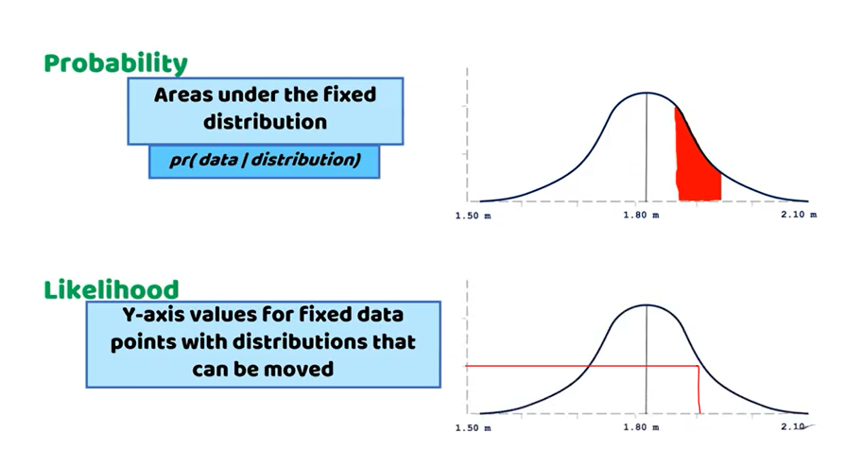
Probability VS Likelihood
Probability is used to finding the chance of occurrence of a particular situation, whereas Likelihood is used to generally maximizing the chances of a particular situation to occur.

Slide 13
Exercise
Why probability is not a Likelihood explain?
Give an example to differentiate between probability and likelihood.

Slide 14
References
Online Video Link-
https://www.youtube.com/watch?v=cC1h77g8KFM
https://www.youtube.com/watch?v=pYxNSUDSFH4
Textbooks / Reference Books
Text Books
T1: Advanced Engineering Mathematics by R.K. Jain and S. R. K. Iyengar, Narosa Publications.
T2: Probability and Statistics for Engineers and Scientists by Sheldon M. Ross, Academic Press.
Reference Books
R1: Fundamental of mathematical Statistics by SC Gupta and VK Kapoor, S. Chand Publication.
R2: Probability by Lipschitz, Schaum outline series, Mc.Graw hill Publication.

Slide 15
References
Books:
Hastie, Trevor, et al., The elements of statistical learning. Vol. 2. No. 1. New York: Publisher: Springer, Edition: Second Edition (2009), ISBN: 978-0387848570
Practical Statistics for Data Scientists: 50 Essential Concepts, Authors: Peter Bruce, et al, Publisher: O'Reilly Media, Edition: Second Edition (2020), ISBN: 978-1492072942
Research Papers:
Carmichael, Iain, and J. S. Marron. "Data science vs. statistics: two cultures?." Japanese Journal of Statistics and Data Science 1.1 (2018): 117-138.
Hardin, Johanna, et al. "Data science in statistics curricula: Preparing students to “think with data”." The American Statistician 69.4 (2015): 343-353.
Websites:
https://365datascience.com/resources-center/course-notes/statistics/
https://www.geeksforgeeks.org/7-basic-statistics-concepts-for-data-science/
Videos:
https://www.youtube.com/playlist?list=PLZ2ps__7DhBYrMs3zybOqr1DzMFCX49xG

Slide 16
THANK YOU
For queries
Email: madan.e13485@cumail.in

